Slide 1
Mathematics for Computer Applications – Unit 1 Course Code: M23DE0101 – Academic year 2024-2025, I Semester MCA (Odd Semester)
School of Computer Science and Applications
Dr M Vinayaka Murthy
Professor

Slide 2
Lecture -1 Introduction, Basic concepts of sets, its types
Agenda
Importance of the Course
Prerequisites for this Course
Course Objectives
Course Content
Course Outcomes
Text Books
Reference Books
Assessment for Course
Introduction
Basic concepts of sets,
Types of Set

Slide 3
Importance of the course
Statistics are facts. Facts supports reality. Quite helpful in just about anything. Probability gives you an estimate of a scenario; i.e. to what extent it will be favorable, unfavorable or neutral to you.
Statistics are a group of principles that are used to attain information about the data so as to make decisions. It unveils the secret hidden in the data.
Probability and Statistics are involved in different predictive algorithms that are there in Machine Learning. They help in deciding how much data is reliable, etc.,
Data Scientist is a person who is better at statistics than any programmer and better at programming than any statistician.

Slide 4
Prerequisites for this course
Number System and its properties,
Set Theory, Relations & Function and its properties,
Algebraic and Logarithmic concepts,
System of equations solving techniques,
Basic knowledge of Differentiation and Integration.

Slide 5
course objectives
Equip students to solve given problems using set theory concepts. Also examine and apply the class of functions which transform a finite set into another finite set which relates to input output functions in computer science.
Introduce Random variables and Probability distributions.
Learn the statistical procedures most often used by practicing all fields.
Understand apply for business applications.

Slide 6
Course Content
UNIT 1: Set Theory, Relation and Functions : Introduction, Basic concepts of sets, and its types, Operations on sets, Venn diagrams, Some basic set identities, Cardinal number and its problems. Cartesian products , Relations, Properties of relations, Equivalence relation, Relation matrix and the Graph of binary relation, Partition set, POSET. Hasse Diagram. Functions and its types, Composition of a functions and Inverse functions, Recursive function.
UNIT 2: Predictive Analytics : Predictive modeling and Analysis - Regression Analysis, Correlation analysis, Rank correlation coefficient, multiple correlation, least square, Curve fitting and goodness of fit.

Slide 7
Course Content contd.
UNIT 3: Random Variable and Probability Distribution: Introduction probability and its property, Random variable, its types DRV, CRV and its distributions, two dimensional R V, joint probability function, marginal density function. Some special probability distribution - Binomial, Poison, Uniform, Exponential and Normal Distribution.
UNIT 4: Hypothesis Testing: Introduction Sampling, Sampling distribution, one and two tailed test, Test of significance, (mean, difference of means), confidence interval 1% and 5% level of significance - Design of Experiments, one way classification, two way classification, ANOVA.

Slide 8
Course Outcomes
Classify variables as quantitative or categorical, create appropriate numerical and graphical summaries for each type, and use these to explain/identify relationships between variables.
Understand, apply and examine the goodness-of-fit test, test for independence, and coefficient of correlation for bivariate data.
Illustrate and apply the concepts of discrete and continuous random variables, the discrete and continuous probability distributions and the joint probability distributions and solve real world problems in appropriate contexts by using standard techniques.
Recognize and compute the single and multi-sample tests for m descriptive and inferential statistics in many different fields.

Slide 9
Text Books
Gupta. S.C and Kapoor V.K. Fundamentals of Mathematical Statistics, Sultan Chand and sons, 2001
Freund J.E., Mathematical Statistics, Prentice hall, 2001
Softcopy of the text book 1:
(https://docs.google.com/file/d/0B6mmcxyrKnEhRnR6V2dpcVNMdGM/edit)

Slide 10
Reference Books
Berenson and Levine, Basic Business Statistics, Prentice- Hall India (1996, 6thedition)
P K Srimani and M Vinayaka Murthy, “Probability and Statistics”, Subhas Stores, 2000
Medhi. J, “Statistical methods - An introductory text”, new age publications, 2009 edition.
D.C. Montogomery and G.C. Runger, “Applied Statistics and Probability for engineers”, New Jersey,John Wiley and Sons, 3rd edition, 2003.
Ross Sheldon, A First Course in Probability, Macmillan , (6th edition)
S M Ross, “Introduction to Probability and Statistics for Engineers and Scientists”, Academic Foundation, 2011

Slide 11
Assessment for Course
The Scheme of Assessment and Evaluation will have TWO PARTS, namely;
i) Internal Assessment (IA); and
ii) Semester End Examination (SEE)
Assessment and Evaluation of each Course shall be for 100 marks. The Internal Assessment (IA) and Semester End Examination (SEE) of PG programs shall carry 50 marks each (i.e., 50 marks internal assessment; 50 marks semester end examination).
The 50 marks of Internal Assessment (IA) shall comprise of:
Internal Test = 30 marks
Assignments = 10 marks
Seminars = 10 marks

Slide 12
Assessment for Course contd.
There shall be two internal tests conducted as per the schedule given below. The students have to attend all the two tests compulsorily.
1st test for 30 marks during 2nd part of the 8th week of the beginning of the semester; and
2nd test for 30 marks during 2nd part of the 16th week of the beginning of the semester.
The coverage of syllabus for the said two tests shall be as under:
For the 1st test the syllabus shall be First and Second Unit of the Course;
For the 2nd test it shall be Third and Fourth Unit of the Course.
The average marks of the two test secured is considered while assessing the performance of the students.

Slide 13
Assessment for Course contd.
There shall be two (or more) Assignments and two (or more) Seminars each carrying equal marks. Hence all the assignments carry total 10 marks and all the seminars carries 10 marks. In place of assignments and seminars, there shall be model designs or some task based activity wherein the number of designs/ activity the marks each design / activity carries shall be decided by the School Board.
The duration of the Internal Test shall be 75 minutes and for Semester End Examination the duration shall be 3 hours.
The Semester End Examination for 100 marks (scale down by 50 marks) shall be held during 19th and 20th week of the beginning of the semester and the syllabus for the semester end examination shall be entire 4 units.

Slide 14
Introduction – set theory
The concept of set serves as a fundamental part of the present day mathematics. Today this concept is being used in almost every branch of mathematics. Sets are used to define the concepts of relations and functions. The study of geometry, sequences, probability, etc. requires the knowledge of sets. The theory of sets was developed by German mathematician Georg Cantor (1845-1918). In this Unit, we discuss some basic definitions and operations involving set.
Set: A well-defined number of collection of objects is known as a set. Its denoted by capital letters of A, B, C, etc.,
Example: 1) A = {1, 2, 3, 4, 5}, 2) B = {a, b, c}, 3) C = {1, 5, a, b, z}

Slide 15
Basic concepts of sets
There are two methods of representing a set. i.e.,
1) Roaster method
Eg: A = {1, 2, 3,... 10}
The set of all vowels in the English alphabet is {a, e, i, o u}
The set of odd natural numbers is represented by {1, 3, 5 ......}
2) Set builder method
Eg: A = {x/1 ≤ x ≤ 10, x ∈ N}
B = {y : y is a vowel in the English alphabet}
C = {z / z is an odd natural number}

Slide 16
Basic concepts of sets - element
Element: Every member (object) of the set is called as an element of a set
Eg: B = {a, b, c}
Here a ∈ B, b ∈ B and c ∈ B, d ∉ B (‘d’ does not belong to B)
If a is an element of a set B, we say that “a belongs to B” the Greek symbol ∈ (epsilon) is used to denote the phrase ‘belongs to’. Thus, we write a ∈ B.
If ‘d’ is not an element of a set B, we write d ∉ B and read “d does not belong to B”.
Thus, in the set V of vowels in the English alphabet = {a, e, i, o u},
a ∈ V but b ∉ V.
In the set P of prime factors of 30 = {2, 3, 5}, 3 ∈ P but 15 ∉ P.

Slide 17
Type of sets
Null set: A set does not contain any elements such set is called as null set or empty set and it is denoted by φ
Eg: φ = { }
Finite set: A set which contain a countable number of elements then the set is called finite set.
Eg: A = {1, 2, 3, ......100} ⇒ n(A) = 100
B = {a, b, c, ......z} ⇒ n(B) = 26
Infinite set: A set having uncountable number of elements then the set is called infinite set.
Eg: A = {1, 2, 3, 4 ......∞}

Slide 18
Type of sets contd.
Sub set : If every element of A is also an element of B then the set A is said to be subset of B and is denoted by “⊆”
i.e., A ⊆ B = {x/x ∈ A → x ∈ B, ∀ x}
Eg. A = {1, 2}, B = {1, 2, 3}, C = {3}, D = {2, 3}
A ⊆ B, C ⊆ B, D ⊆ B, C ⊆ D
Equal sets: If A and B be the two sets and A is the subset of B and also B is subset of A then A and B are called equal sets i.e., A = B
Eg: A = {1, 2, 3}, B = {2, 1, 3}
A ⊆ B and B ⊆ A ⇒ A = B

Slide 19
Type of sets contd.
Proper subset : If A is a subset of B and A ≠ B then A is called proper subset of B.
Eg: A = {1, 2, 3}, B = {1, 2, 3, 4}
A ⊆ B but A ≠ B ⇒ A ⊂ B
Equivalence set: If A and B be the two sets and A ⊄ B and B ⊄ A but both the sets equal number of elements than the set A and B are called as equivalent.
Eg: A = {1, 2, 3}, B = {a, b, c}
A ⊄ B, and B ⊄ A but n(A) = n(B) = 3
A ≡ B

Slide 20
Type of sets contd.
Power set: Given set A, the power set of A is the set of all subset of set A and denoted by 2^{A} or ρ(A)
Eg: A = {1, 2}
2^{A} = ρ(A) = { { }, {1}, {2}, {1, 2} }
Note : No. of subsets = 2^{m} where m is number of elements in set.
= 2² = 4

Slide 21
SUMMARY
Importance of the Course
Prerequisites for this Course
Course Objectives
Course Content
Course Outcomes
Text Books
Reference Books
Assessment for Course
Introduction
Basic concepts of sets,
Types of Set

Slide 22
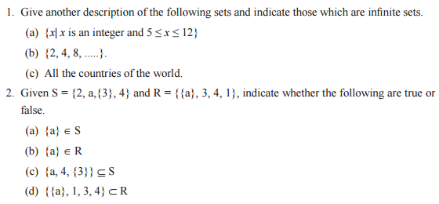
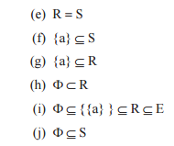
Problems for practice

Slide 23

Lecture -2, Operations on sets and its applications
OBJECTIVE
Introduction
Basic concepts of sets,
Types of Set
Operations on Sets
Operations on Sets Problems
Operations on Sets Applications

Slide 24
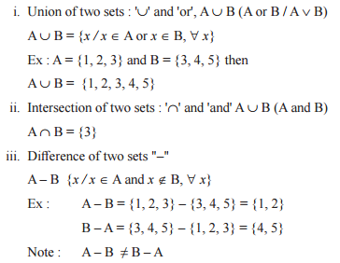
Operations on sets

Slide 25
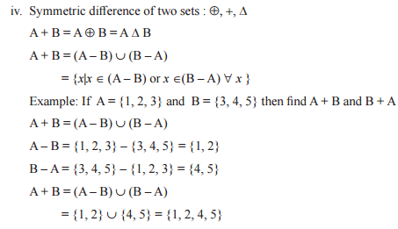
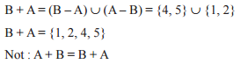
Operations on sets CONTD.

Slide 26
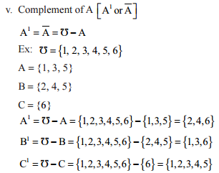
Operations on sets CONTD.

Slide 27
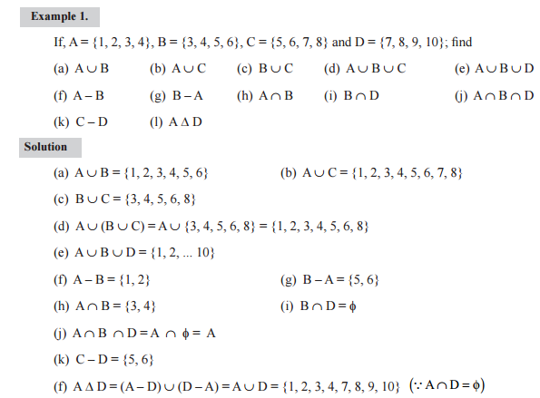
Operations on set problems

Slide 28
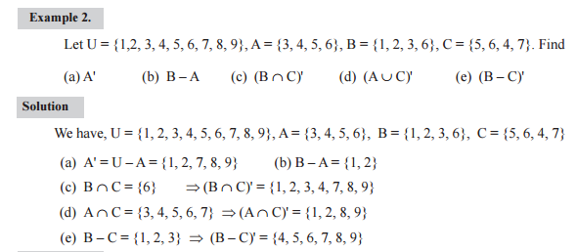
Operations on set Applications

Slide 29
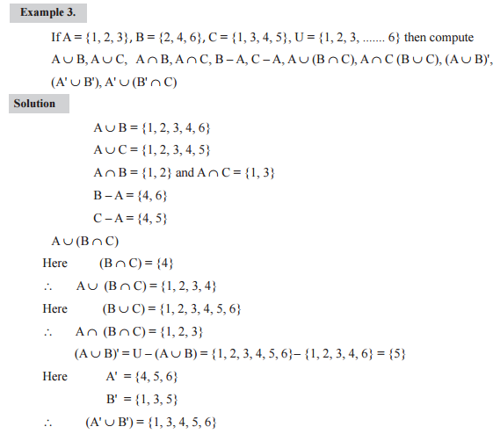
Operations on set Applications contd.

Slide 30
SUMMARY
Operations on Sets
Operations on Sets Problems
Operations on Sets Applications

Slide 31
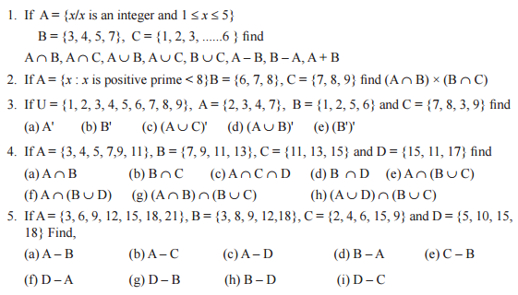
Problem for practice

Slide 32
Lecture -3, Venn diagrams, Some basic set identities, and its applications
OBJECTIVE
Operations on Sets
Operations on Sets Problems
Operations on Sets Applications
Venn Diagrams
Basic Set Identities
Set Identities Applications

Slide 33
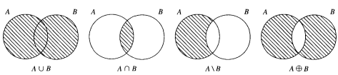
Venn Diagrams
Sets can be represented graphically using Venn diagrams, named after the English mathematician John Venn, who introduced their use in 1881. In Venn diagrams the universal set U, which contains all the objects under consideration, is represented by a rectangle. (Note that the universal set varies depending on which objects are of interest.) Inside this rectangle, circles or other geometrical figures are used to represent sets. Sometimes points are used to represent the particular elements of the set. Venn diagrams are often used to indicate the relationships between sets

Slide 34
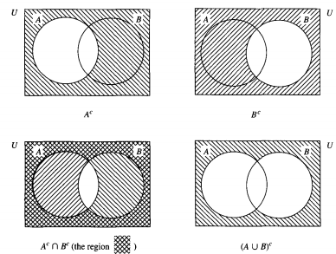
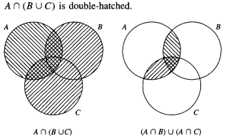
Venn Diagrams contd.

Slide 35
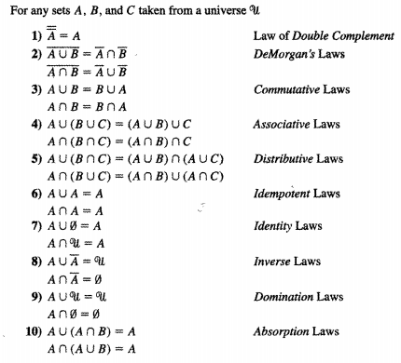
Basic Set Identities

Slide 36
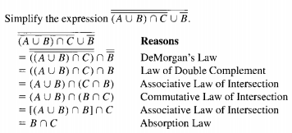
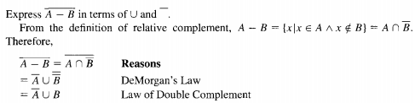
Set Identities Applications

Slide 37
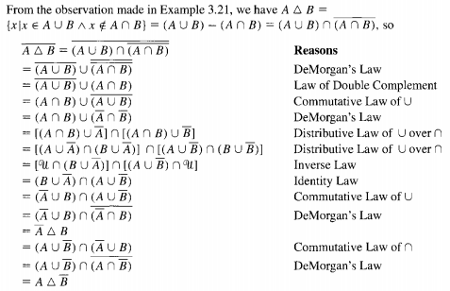
Set Identities Applications contd.

Slide 38
SUMMARY
Venn Diagrams
Basic Set Identities
Set Identities Applications

Slide 39
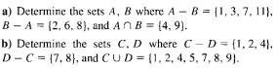
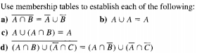
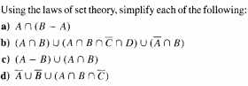
Problems for practice

Slide 40
Lecture -4, Cardinal number and its problems.
OBJECTIVE
Venn Diagrams
Basic Set Identities
Set Identities Applications
Cardinal Number
Cardinal Number Problems

Slide 41
Cardinal Number
Cardinal Number: A finite set “A” have countable number of elements that number is called cardinal number of set A and it’s denoted by n(A) (or |A|)
Example: (1) If A = {a, b, c, d, e} then |A| = n(A) = 5
(2) If B = {1, 2, … 10} then |B| = n(B) = 10

Slide 42
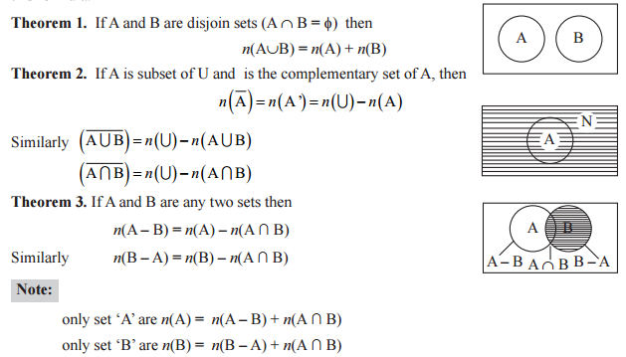
Cardinal Number Problems

Slide 43
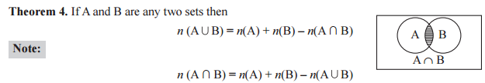
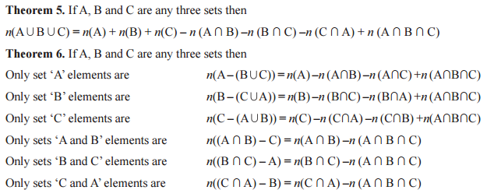
Cardinal Number Problems contd.

Slide 44
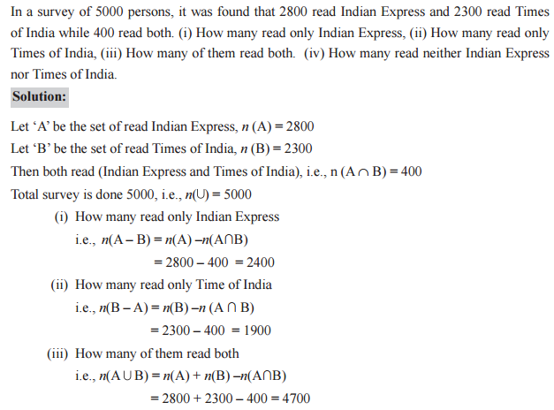
Cardinal Number Problems contd.

Slide 45
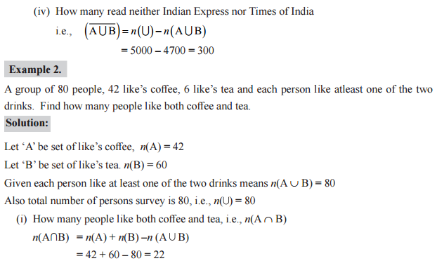
Cardinal Number Problems contd.

Slide 46
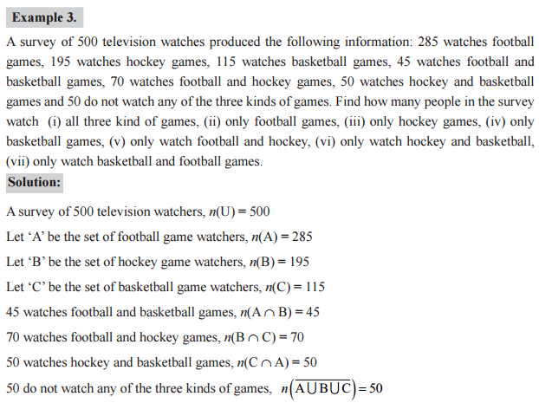
Cardinal Number Problems contd.

Slide 47
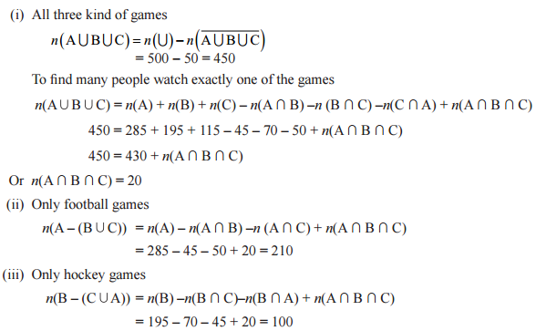
Cardinal Number Problems contd.

Slide 48
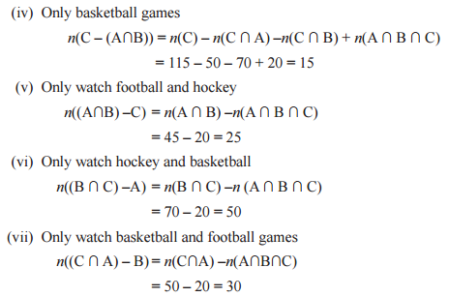
Cardinal Number Problems contd.

Slide 49
SUMMARY
Cardinal Number
Cardinal Number Problems

Slide 50
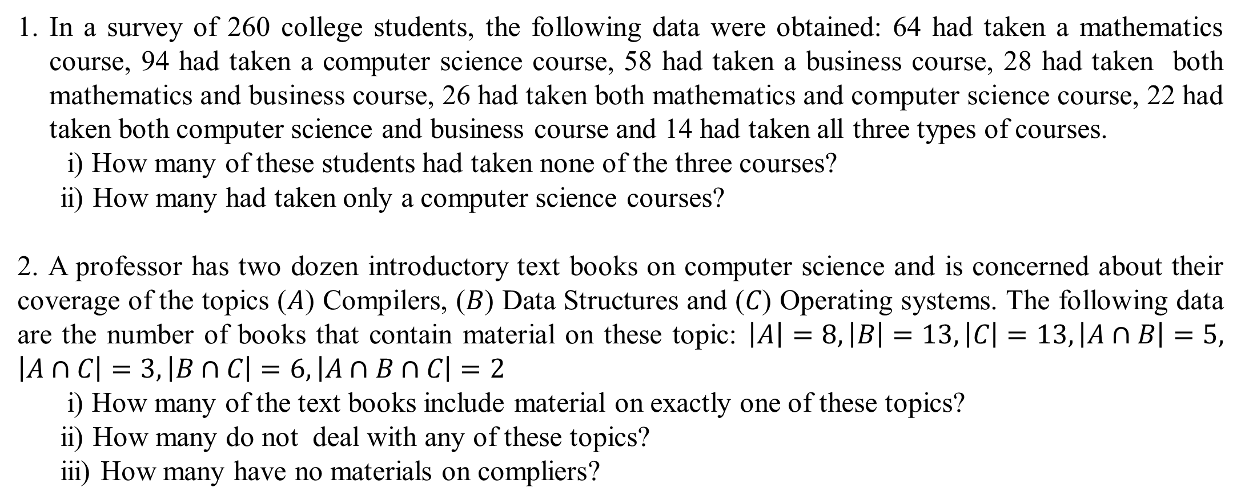
Problems for practice
In a survey of 260 college students, the following data were obtained: 64 had taken a mathematics course, 94 had taken a computer science course, 58 had taken a business course, 28 had taken both mathematics and business course, 26 had taken both mathematics and computer science course, 22 had taken both computer science and business course and 14 had taken all three types of courses.
i) How many of these students had taken none of the three courses?
ii) How many had taken only a computer science courses?
2. A professor has two dozen introductory text books on computer science and is concerned about their coverage of the topics ($A$) Compilers, ($B$) Data Structures and ($C$) Operating systems. The following data are the number of books that contain material on these topic: $\left|A\right|=8, \left|B\right|=13, \left|C\right|=13, \left|A∩B\right|=5,$ $\left|A∩C\right|=3, \left|B∩C\right|=6, \left|A∩B∩C\right|=2$
i) How many of the text books include material on exactly one of these topics?
ii) How many do not deal with any of these topics?
iii) How many have no materials on compliers?

Slide 51
Lecture -5, Cartesian products, Relations, Properties of relations
OBJECTIVE
Cardinal Number
Cardinal Number Problems
Cartesian Products
Relations
Properties of Relations
Types of Relations

Slide 52
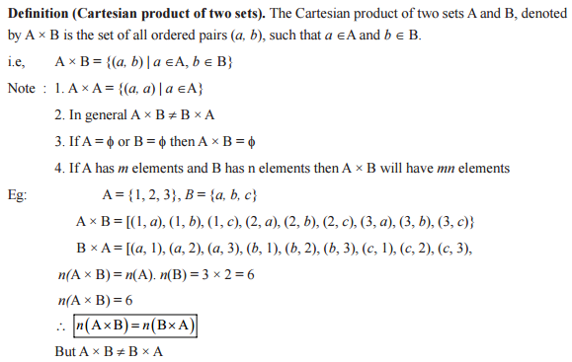
Cartesian Products

Slide 53
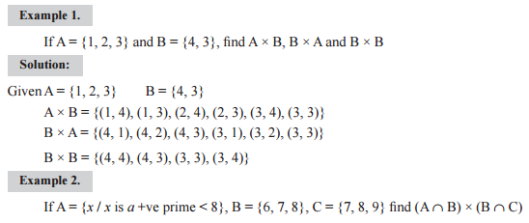
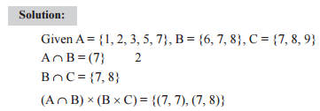
Cartesian Products

Slide 54
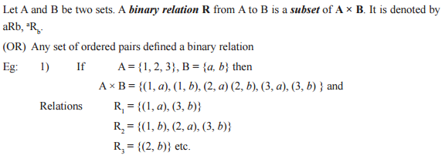
Relations

Slide 55
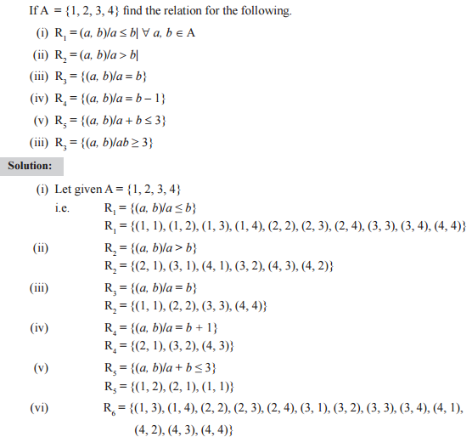
Relations contd.

Slide 56
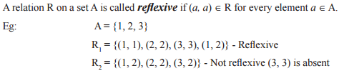
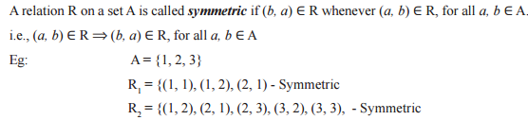
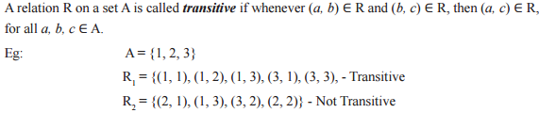
Properties of relations

Slide 57
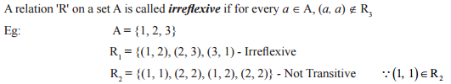
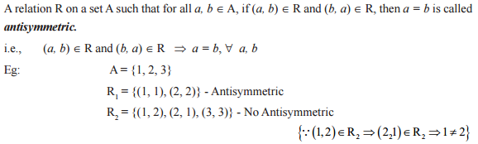
Properties of relations contd.

Slide 58
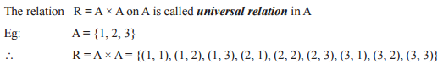
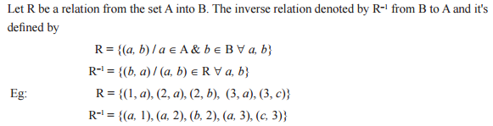
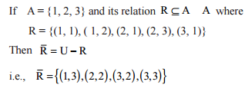
Types of Relations

Slide 59
SUMMARY
Cartesian Products
Relations
Properties of Relations
Types of Relations

Slide 60
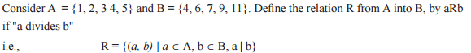
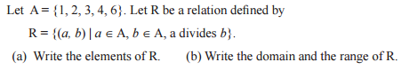
Problem for practice

Slide 61
Lecture -6, Equivalence relation and composite of relations problems
OBJECTIVE
Cartesian Products
Relations
Properties of Relations
Types of Relations
Equivalence Relation
Composite of Relation

Slide 62
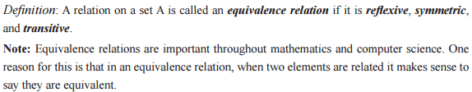
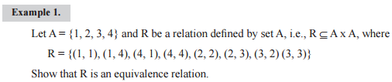
Equivalence Relation

Slide 63
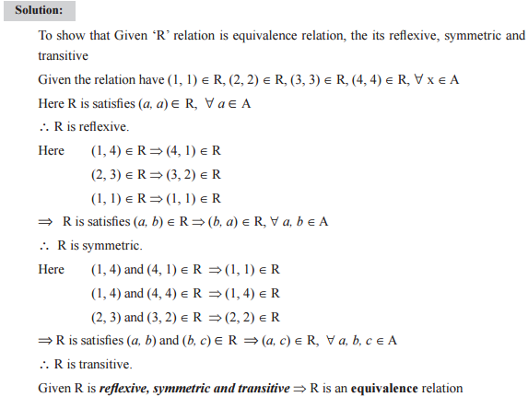
Equivalence Relation contd.

Slide 64
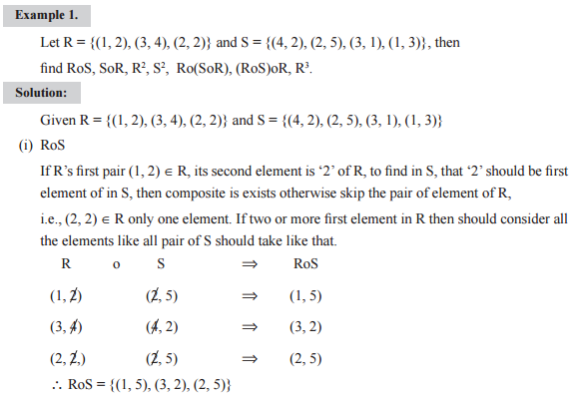
Composite of Relation

Slide 65
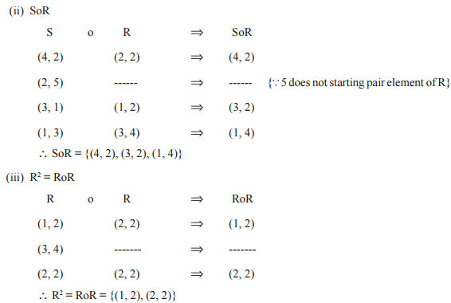
Composite of Relation contd.

Slide 66
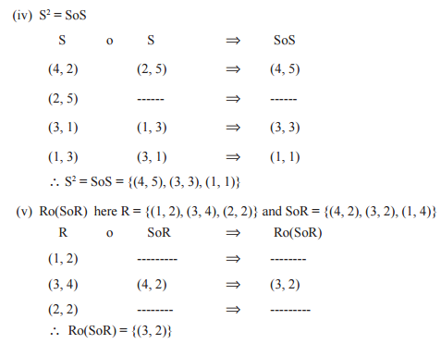
Composite of Relation contd.

Slide 67

Composite of Relation contd.

Slide 68
SUMMARY
Equivalence Relation
Composite of Relation

Slide 69


Problems for practice

Slide 70

Lecture -7, Relation matrix and its application problems
OBJECTIVE
Equivalence Relation
Composite of Relation
Relation Matrix
Relation Matrix Problems

Slide 71



Relation Matrix

Slide 72

Relation Matrix problems

Slide 73


Relation Matrix problems contd.

Slide 74


Relation Matrix problems contd.

Slide 75
SUMMARY
Relation Matrix
Relation Matrix Problems

Slide 76

Problems for practice

Slide 77
Lecture -8, Graph of binary relation problems
OBJECTIVE
Relation Matrix
Relation Matrix Problems
Relation Graph
Relation Graph Problems

Slide 78

Relation graph
We have shown that a relation can be represented by listing all of its ordered pairs or by using a zero–one matrix. There is another important way of representing a relation using a pictorial representation. Each element of the set is represented by a point, and each ordered pair is represented using an arc with its direction indicated by an arrow. We use such pictorial representations when we think of relations on a finite set as directed graphs, or digraphs.

Slide 79

Relation graph contd.

Slide 80

Relation graph problems
Let X = {1, 2, 3, 4} and R = {x, y} {x ≥ y} Draw the graph of R and also its matrix
Solution:
Let Given X = {1, 2, 3, 4}
∴ R = {(1, 1), (2, 1), (2, 2), (3, 1), (3, 2), (3, 3), (4, 1), (4, 2), (4, 3), (4, 4)}
Relation matrix Relation graph

Slide 81


Relation graph problems contd.
2. Find the relation matrix of the following graph
Solution:
R = {(a, a), (a, b), (a, d), (b, a), (b, b), (b, c), (c, b), (c, c), (d, a), (d, d)}
Relation matrix

Slide 82
SUMMARY
Relation Graph
Relation Graph Problems

Slide 83

PROBLEMS FOR PRACTICE
1. List the ordered pairs in the relations represented by the directed graphs

Slide 84
Lecture -9, Partition set, POSET
OBJECTIVE
Relation Graph
Relation Graph Problems
Partition Set
POSET

Slide 85


Partition set

Slide 86

Partition set contd.

Slide 87

P o s e t
Let ‘A’ be a set with ‘R’ a relation on ‘A’. The pair ( A, R) is called a Partially Ordered Set ( or POSET), If relation R on A is a partial order, or partial ordering.
If ‘A’ is called a poset, we understand that there is a partial order R on A that makes A into this poset.

Slide 88

P o s e t contd.

Slide 89
SUMMARY
Partition Set
POSET

Slide 90
Problems for practice
Let X = {a, b, c, d, e} and let C = {{a, b}, {c}, {d, e}}. Show that the partition C defines an equivalence relation on X.
If A = {1, 2, 3, 4} and B ={(1, 2), (3, 4)} is a partition of A, obtain the equivalence relation R on A induced by the given partitions.

Slide 91
Lecture -10, Hasse Diagram problems
OBJECTIVE
Partition Set
POSET
HASSE Diagram
Hasse Diagram Problems

Slide 92


Hasse Diagram

Slide 93

Hasse Diagram

Slide 94


Hasse Diagram problems
Constructing the Hasse Diagram of ({1, 2, 3, 4, 6, 8, 12},|).

Slide 95

Hasse Diagram problems contd.
3. Draw the Hasse diagram for the partial ordering {(A, B) | A ⊆ B} on the power set P(S) where S = {a, b, c}.
The Hasse Diagram of (P ({a, b, c}), ⊆).

Slide 96
SUMMARY
HASSE Diagram
Hasse Diagram Problems

Slide 97

Problems for practice

Slide 98
Lecture -11, Functions and its types
OBJECTIVE
HASSE Diagram
Hasse Diagram Problems
Function
Types of Functions

Slide 99
Functions
Def : Let A and B be two non empty sets then a function (or mapping) from the set A into set B, is a relative from A to B such that
(i) ∀ a ∈ A, ∃ b ∈ B, such that (a, b) ∈ f
(ii) (a, b) ∈ f and (a, b1) ∈ f ⇒ b = b1, ∀ a ∈ A, b, b1 ∈ B.
The function is defined by f : A → B
The set B is called Codomain (range) of f
‘b’ is called image of a under f and ‘a’ is called preimage of ‘b’ under f
Symbolically f = [(a, f (a)) / ∀ a ∈ A, ∃ f (a) ∈ B }
and f(a) ≠ f(a1) ⇒ a1 ≠ a,
f(a) = f(a1) ⇒ a = a1

Slide 100


Functions contd.

Slide 101
types of Functions
1. Identity function : A function f : A → A such that f(a) = a, ∀ a ∈ A is called the identity function.
Eg: If A = {a, b, c} then f : A → A defined f(a) = a, f(b) = b, f(c) = c.
2. Constant function : A function f : A → B such that f(a) = K, ∀ a ∈ A where K is a fixed element of B is called constant function.
Eg: Let A = {1, 3, 5, 7} and B = {2, 4, 6, 8}
Define f(1) = 6, f(3) = 6, f(5) = 6 and f(7) = 6

Slide 102


Types of Functions contd.
3. Onto function (Surjective function) : A function f : A → B is said to be an onto function (Surjective) if ∀ b ∈ B, ∃ atleast one element a ∈ A such that f(a) = b { codomain = image}
A function f : A → B is said to be onto iff R(f) = B
4. Into function: A function f : A → B is said to be into function if R(f) is a proper subset of B i.e. R (f) ⊂ B

Slide 103

Types of Functions contd.
5. One to one function (injective function) : A function f : A → B is said to be injective if ∀ a, a2, ∈ A, a1 ≠ a2 ⇒f(a1) ≠ f(a2)
or ∀ a1, a2, ∈ A, a1 = a2 ⇒f(a1) = f(a2)
Other: The function f is said to be one to one if the distinct elementary of A have distinct
image in B.

Slide 104

Types of Functions contd.

Slide 105
Types of Functions contd.

Slide 106
Types of Functions contd.

Slide 107
SUMMARY
Function
Types of Functions

Slide 108
Problems for practice

Slide 109
Lecture -12, Composition of a functions and Inverse functions problems
OBJECTIVE
Function
Types of Functions
Composition of a Functions
Inverse Function

Slide 110
Composition of a Functions
Definition: Let R be a relation from a set A to a set B and S a relation from B to a set C. The composite of R and S is the relation consisting of ordered pairs (a, c), where a ∈ A, c ∈ C, and for which there exists an element b ∈ B such that (a, b) ∈ R and (b, c) ∈ S. We denote the composite of R and S by RoS.
RoS = {(a, c) / (a, b)∈ R ∧ (b, c)∈S }
Note: R² = RoR,
R³ = R²oR = RoR².

Slide 111

Composition of a Functions contd.

Slide 112

Composition of a Functions contd.

Slide 113

Composition of a Functions contd.

Slide 114

Composition of a Functions contd.

Slide 115


Inverse of Functions
Inverse function : A function f : A → B be a bijective function then the function f : B → A defined by f ^{–1} (b) = a such that f(a) = b is called inverse function.
f ^{–1} (b) = a, ∀ b ∈ B, such that f(a) = b.

Slide 116


Inverse of Functions contd.

Slide 117
SUMMARY
Composition of a Functions
Inverse Function

Slide 118


Problems for practice

Slide 119
Lecture -13, Recursive function problems
OBJECTIVE
Composition of a Functions
Inverse Function
Recursive Function
Recursive Function Problems

Slide 120
Recursive Function
Sometimes it is difficult to define an object explicitly. However, it may be easy to define this object in terms of itself. This process is called recursion.
Example: The values of the terms in a sequence may be given explicitly by formulas such as
S_{n} = n³ – 73n
or by descriptions such as “let t, be the weight of the nth edge on the path.” Terms may also be defined by descriptions that involve other terms that come before them in the sequence.

Slide 121

Recursive Function problems

Slide 122

Recursive Function problems contd.

Slide 123

Recursive Function problems contd.

Slide 124

Recursive Function problems contd.

Slide 125
SUMMARY
Recursive Function
Recursive Function Problems

Slide 126


Problems for practice

